Slide 1
SiDe Event: Wednesday 22 May 2013 disaster risk reduction: government to governance
From Disaster Management to integrative risk management: The paradigm shift in DRR
Walter J. Ammann, CEO, Global Risk Forum GRF Davos, Davos, Switzerland
walter.ammann@grforum.org
Notes:
First, we have to ask ourselves „do we know all our risks“ because as peter sandmannn says, the risks….

Slide 2
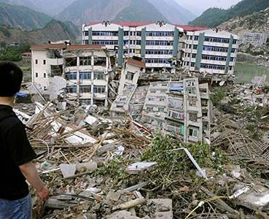
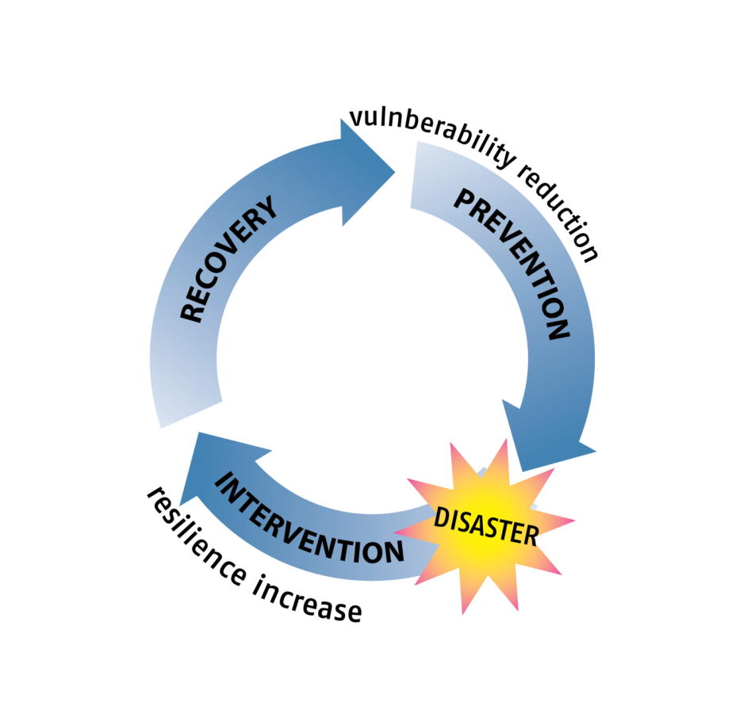
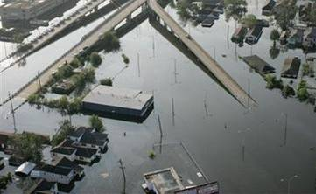
disaSTER RISK REDUCTION DRR
DRR?
Disaster management (how to deal with a risk which has just become reality)
Risk reduction (how to prevent or limit potential future disasters)

Slide 3

Risks: the Hazard side
Processes

Slide 4
Risks – The Values and Vulnerabilities
Values exposed to hazards
Vulnerability
Damage potential

Slide 5
Risk – existing values and damage potential
Values exposed to hazards
Damage potential
Processes
RISK
Risks and opportunities (values) are twins
no development without risks

Slide 6

DRR – conceptual Framework
How safe is safe enough?
Paradigm shift:
Risk based approach (ex-ante): proactive prevention
Instead of:
Disaster centered approach (ex-post): intervention/ recovery
What is acceptable to happen?
What can happen?
Hazard analysis (hazard intensity and exposure analysis, vulnerability, Scenarios important
What is an accepted safety level? (Protection goals, acceptable risk levels)
Risk Analysis
Risk Assessment
What has to be done?
Measures to be taken

Slide 7

Governance to ensure Multi risk approach ensure comparability of risks
FLOODS
SEVERE WINDSTORMS
EARTHQUAKES/ TSUNAMIS
DROUGHTS, DESERTIFICATION
GLOBAL CLIMATE CHANGE
RESOURCE SCARCITIES
LAND DEGRADATION
SOCIAL UNRESTs
PANDEMICS
BIOLOGICAL HAZARDS
FINANCIAL CRISES
TECHNOLOGICAL HAZARDS
BIOLOGICAL THREATS
TERRORISM

Slide 8
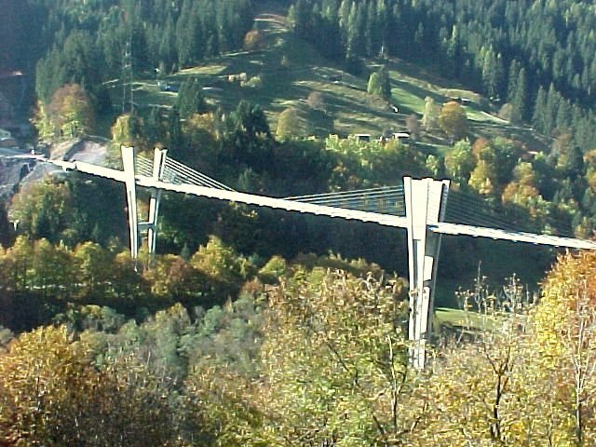
Governance to link all the various stakeholders and scales
Policy makers
Decision makers
Administration
Practitioners
Private Sector
Society
Critical Infrastructures’ facilitators
(private/public)
Media
Scale
local - community/city - regional – national - international

Slide 9

How to achieve the paradigm shift
National risk strategy
Risk concept (unifying the risk based approach)
Governance is key!

